Slide 1
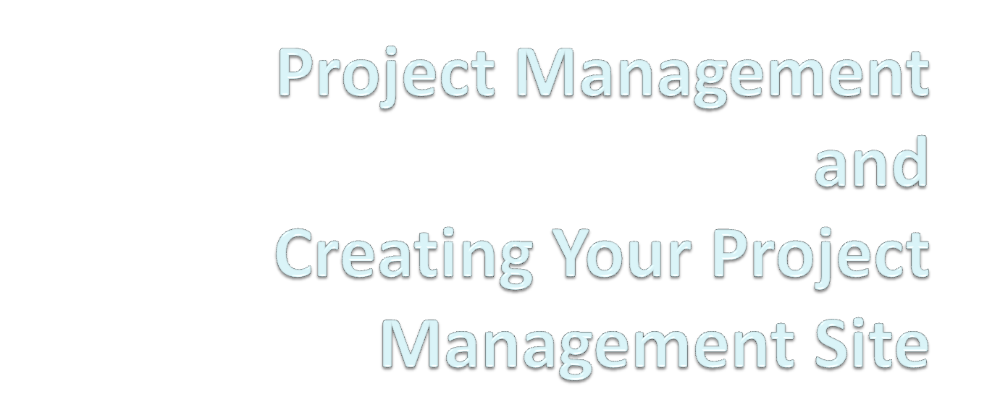

CSE 593
Dr. Yinong Chen
Notes:
Dr. Yinong Chen

Slide 2
What is a Project?
A temporary endeavor undertaken to create a unique product or service. The key components include:
  Project scope;
  Functional and non-functional requirements;
  Deliverables;
  Team and members;
  Budget;
  Equipment;
  Milestones and Timeline.
Purposes of the CSE593 Project
  Purposes are twofold: Exercise the engineering process and complete a useful project
  This lecture and the following lectures are general and may or may not necessarily specific to CSE593.
Dr. Yinong Chen
Notes:
Dr. Yinong Chen

Slide 3
What is Project Management?
We are living in a dynamically changing world; particularly, in the computing and IT professions;
Project planning and implementation need to adapt to the environment;
Project management is a method and a mindset of a systematic and disciplined approach to managing chaos;
Project management provides a framework that pre-programs (plans) all the foreseeable changes and deals with the risk and unforeseeable changes.
Dr. Yinong Chen
Notes:
Dr. Yinong Chen

Slide 4
Leadership and Management Skills
Vision and Strategy
Establishing Direction
Aligning People
Communication and negotiation
Motivating and Inspiring
Overcoming Barriers to scope change
Scoping
Planning
Finance and Accounting
Personnel Administration
Technology
Delegation
Team Building
Conflict and risk Management
Solving Problems
Dr. Yinong Chen
Notes:
Dr. Yinong Chen

Slide 5
Basic Elements of
Successful Project Management
The application of knowledge, skills, tools, and techniques to project objectives to meet stakeholder needs and expectations.
Scope Management:
Project size, objectives, limitations, requirements, and change of scope
Resource Management:
People, equipment, material, and documents
Time Management:
Task schedule and durations, dependencies, and critical path
Money Management:
Budget, costs, contingencies, and profit
Risk Management:
Plan for uncertainty and loss
Dr. Yinong Chen
Notes:
Dr. Yinong Chen

Slide 6
Scope Management: Limit the Scope
In order to make good trade-off among different objectives, the scope of the objectives must be limited.
Level of quality required: Not the higher the better;
Level of performance required;
Field factors and application environment (in air, on ground, or underwater);
What are the maintenance strategies?
What are the dominant sources of impairments and their probabilities?
Level of flexibility and extensibility
Budget available and investment return period
Dr. Yinong Chen
Notes:
Dr. Yinong Chen

Slide 7
Scope Management (One Scenario)
Project
Objectives
Activity
Sequencing
Activity
Definition
Schedule
Development
Scope
Limitation
Duration
Estimating
Cost
Budgeting
Resource
Planning
Cost
Estimating
Plan
Development
Dr. Yinong Chen
Notes:
Dr. Yinong Chen

Slide 8
Resource (People) Management
The majority of the project management problems are people related
Conflict over personal schedule, priority, and goals
Destructive team member behaviors
  The Tank: A person who dominates a discussion or issue by brute force of personality.
  Solution: thank him/her for the opinion, then ask if there are some other perspectives from other team members
  The Grenade: The conversation goes along fine and all of the sudden, a member lobs out a discussion-ending comment.
  Solution: Address the comment head on and suggest that the grenade thrower refrain from comments that will upend conversation of alternatives.
Dr. Yinong Chen
Notes:
Dr. Yinong Chen

Slide 9
Resource (People) Management
Destructive team member behaviors
  The No Person: A person who habitually expresses negative or pessimistic views. Nothing will work, no matter what.
  Solution: Make clear that no is not an option. Define alternatives.
  The Yes Person: A person is so agreeable that he/she negates the influence through a lack of objective analysis.
  Solution: Point out that you appreciate the positive outlook, but one needs to explore options more thoroughly if one wants to gain credibility in group project.
  The Maybe Person: A person who cannot commit to any position. He/She takes refuge in ambiguity.
  Solution: Help to commit by giving simple alternatives to decide
Dr. Yinong Chen
Notes:
Dr. Yinong Chen

Slide 10
Basic Elements
Scope Management:
Project size, goals, requirements, and change of scope
Resource Management:
People, equipment, material, and documents
Time Management:
Task schedule and durations, dependencies, and critical path
Money Management:
Budget, costs, contingencies, and profit
Risk Management:
Plan for uncertainty and loss
Dr. Yinong Chen
Notes:
Dr. Yinong Chen

Slide 11
Project Management Tools
Many tools available
Microsoft Project
DotProject: www.dotproject.net
Excel, Word,
…
Google Project
  Comprehensive tool set
  Service-oriented computing paradigm
  Web 2.0 / Wiki collaborative platform
  Integrated into ASU authentication system
  …
Alternative acceptable, if it has similar key features above
Dr. Yinong Chen
Notes:
Dr. Yinong Chen

Slide 12
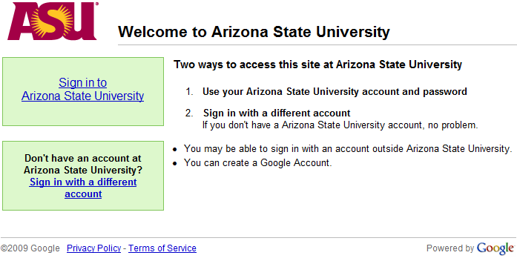
Google Project Management Sites
https://sites.google.com/a/asu.edu/sites/
Dr. Yinong Chen
Notes:
Dr. Yinong Chen

Slide 13
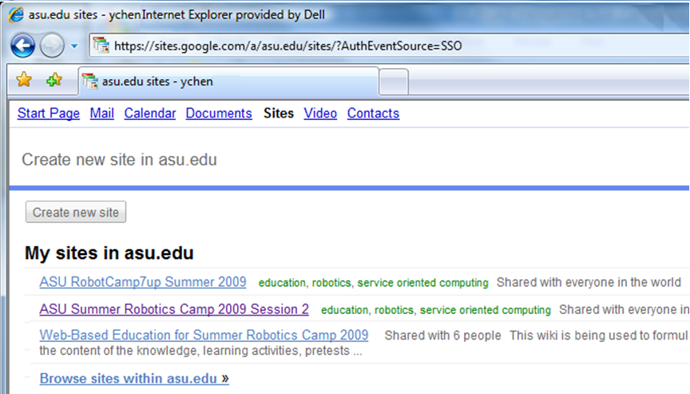
Sign in Using Your ASURITE ID
Dr. Yinong Chen
Notes:
Dr. Yinong Chen

Slide 14
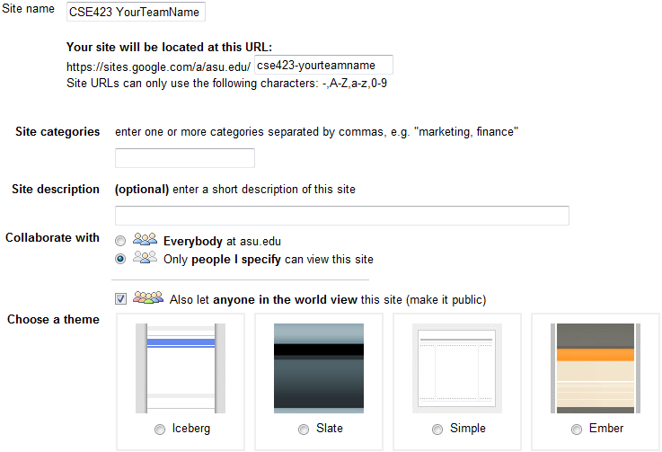
Create Your Team Project Site
Dr. Yinong Chen
Notes:
Dr. Yinong Chen

Slide 15
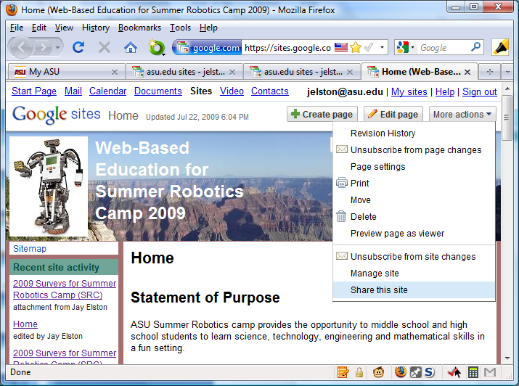
Invite Team Members
Click
“More Actions”
Then click
“Share This Site”
Dr. Yinong Chen
Notes:
Dr. Yinong Chen

Slide 16
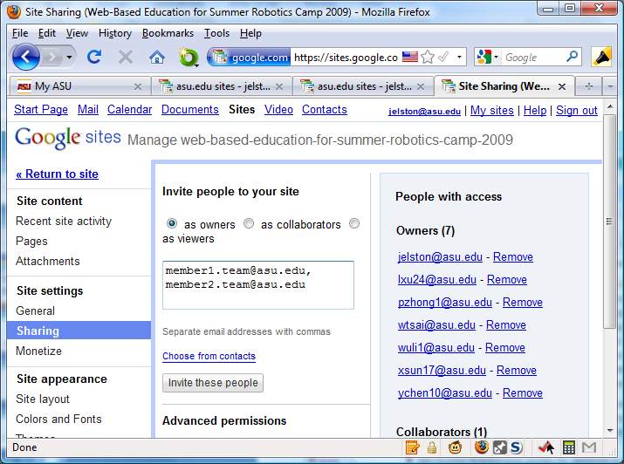
Invite Members
Select “as Owners”
Or “as collaborators”
Then enter
members’
email addresses
All team members
Advisor
Instructor and TA
Dr. Yinong Chen
Finally, click “Invite these people”.
Notes:
Dr. Yinong Chen

Slide 17
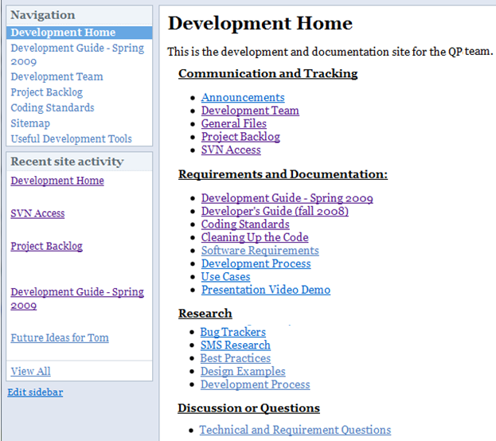
Add Your Project Contents into the Site
Dr. Yinong Chen
Notes:
Dr. Yinong Chen

Slide 18
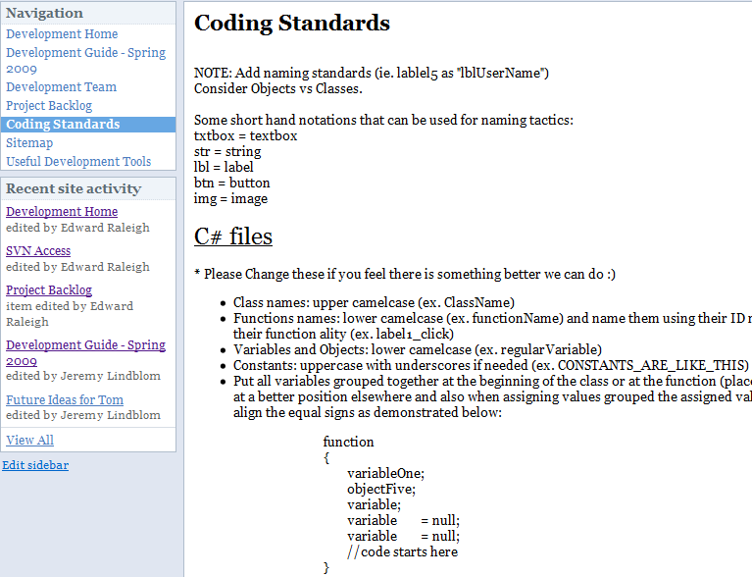
Contents: Coding Standard
Dr. Yinong Chen
Notes:
Dr. Yinong Chen

Slide 19
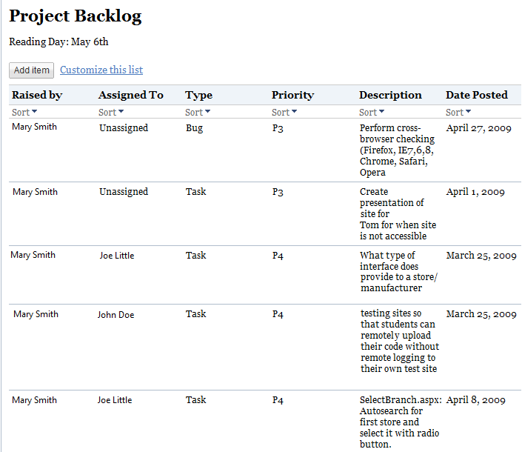
Contents: Project Backlog
Dr. Yinong Chen
Notes:
Dr. Yinong Chen

Slide 20
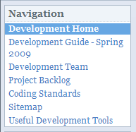
Required Contents (Including but Not Excluding)
Reports
  Meeting Minutes
  Bi-weekly Reports
  Mid-Term Presentation Slides
  Mid-Term Report
  Final Presentation Slides
  Final Report
Project Execution
  Contact Us
    Project Team: Members and contacts
  About Us
    Project Goals & Purpose
    Project Sponsors and Instructors
  Specification
  Schedule: Gannt Chart
  Project Backlog
  Coding Standards
  Sitemap
  Useful Development Tools
…
Dr. Yinong Chen
Notes:
Dr. Yinong Chen

Slide 21
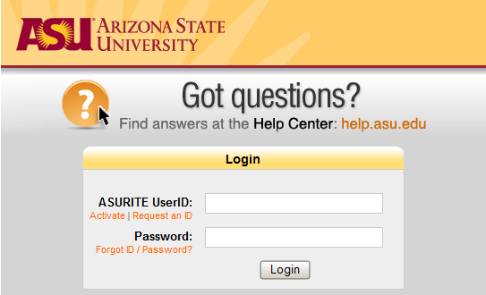
A Sample Site
Link to Sample Project Management Site
https://sites.google.com/a/asu.edu/sample-cse-423-capstone-team-management-site/
Dr. Yinong Chen
Notes:
Dr. Yinong Chen

Slide 22
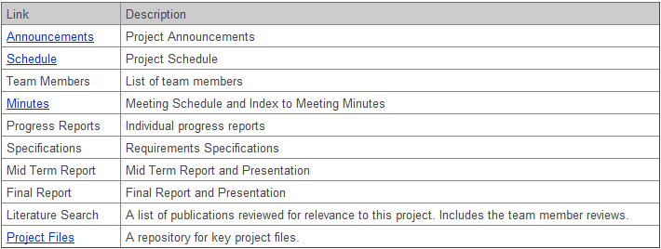
Sample CSE Capstone Team Management Site
This Sample site does not have all required contents;
You can build a better site than this sample!
You are encouraged to build a project site!
Dr. Yinong Chen
Notes:
Dr. Yinong Chen

